Slide 1
IBM APPLIED DATA SCIENCE CAPSTONE PROJECT
Finding the Best Neighborhoods to Open a Few African Restaurants in Toronto

Slide 2
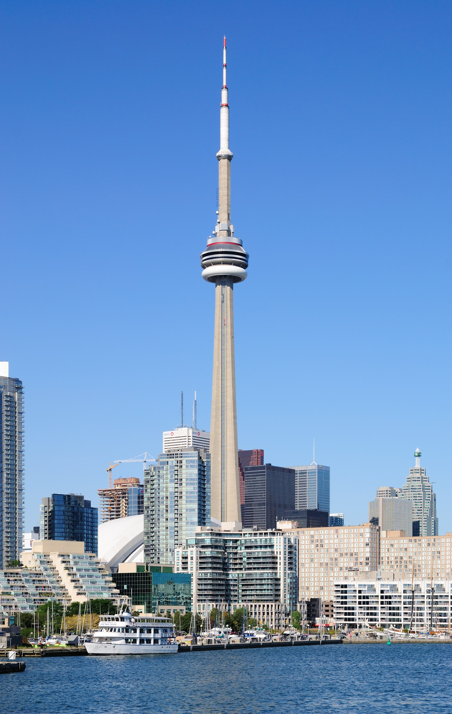
Introduction
Provincial capital of Ontario
Most populous CMA in Canada with 5.9M and the fourth most populous city in North America
Nearly half the population of Toronto is foreign-born
Toronto is home to more than 140 languages,including English, Cantonese, Mandarin, Tagalog, Italian, Spanish, Farsi, Russian, Korean, Tamil, Urdu, Polish, Somali, Arabic
A city of diversified tastes, including Italian, Chinese, Japanese, Ethiopian, etc.

Slide 3
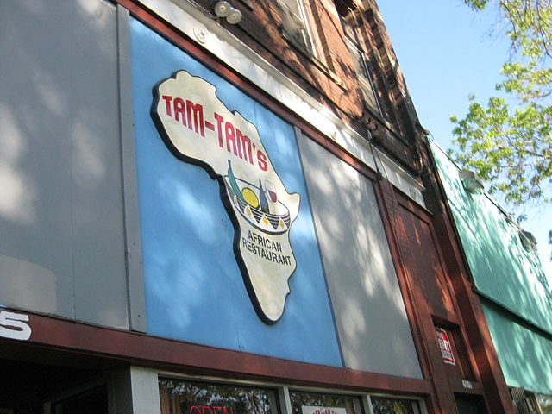
Business Problem
Exploring opportunities to open a few restaurants in Toronto

Slide 4



Data Sources
Toronto Data
Geocoder
Foursquare API
A csv file that provides information about the boroughs and neighborhoods along with the postal codes in Toronto:
Source: https://en.wikipedia.org/wiki/List_of_postal_codes_of_Canada:_M
Used to map the geographical coordinates of the neighborhoods through the postal code
Source: http://cocl.us/Geospatial_data
used to retrieve data from the Foursquare database, and explore venues and types of restaurant in Toronto Neighborhoods
Source: https://developer.foursquare.com/docs/places-api/

Slide 5

Approach
First find out whether there African restaurants in Toronto
Determine the corresponding neighborhoods and the stories behind them, which might be used to open similar restaurant in other neighborhoods
Consider top neighborhoods with the most international restaurants associated with the top communities having the highest percentage of black population to will help determine the rights cluster for opening the few restaurants in Toronto

Slide 6
Methodology
Scraped data and build a data frame of Toronto contains its Boroughs’ list, Neighborhoods along with their latitude and longitude.
Use the Geocoder to map the geographical coordinates of the neighborhoods through the postal code
Use Foursquare API to explore the neighborhoods in Toronto by venues while focusing only on restaurants
Check whether there is an African restaurant. If yes check out the corresponding neighborhood and discard it from the list if it's not on the list of the top neighborhoods
List and plot the 10 top international restaurants by frequency in Toronto
List the top international restaurants for the selected top neighborhoods
Cluster the top neighborhoods based on the frequency of international restaurants by using k-means
Cluster visualization
Clusters Exploring
Results and selection of the ideal location to open a few African restaurants
Discussions
Conclusion

Slide 7

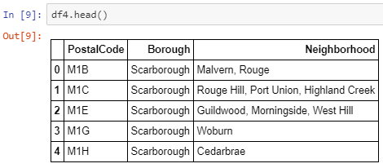
Web Scraping to Create Toronto Data Frame
Used beautifulSoup to scrape a data frame of Toronto from the csv file from the Wikipedia page below
List of postal codes of Canada: M

Slide 8
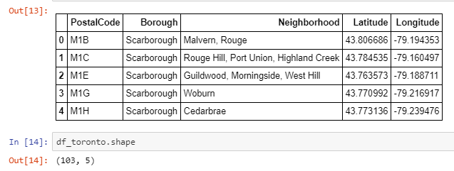
Create the Data Frame With Longitude and Latitude
Geocoder
Used to map the geographical coordinates of the neighborhoods through the postal code
Source: http://cocl.us/Geospatial_data

Slide 9
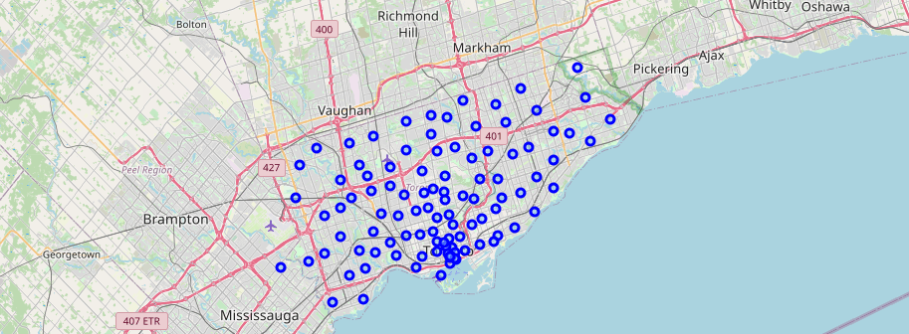
Map of Toronto Neighborhoods

Slide 10
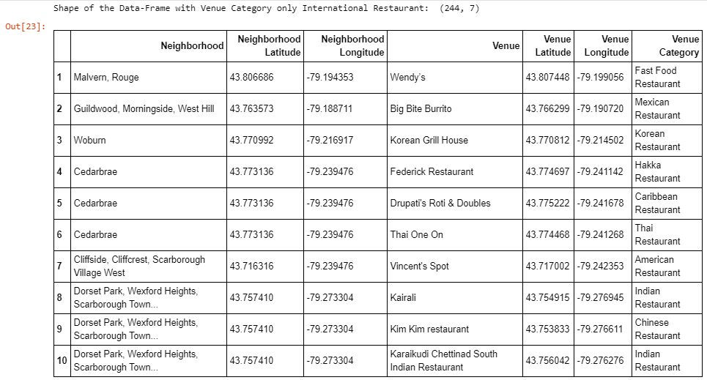
Used Foursquare API to Create a Data of International Restaurants in Toronto
There are 41 unique types or restaurants in Toronto, including an Ethiopian Restaurant

Slide 11
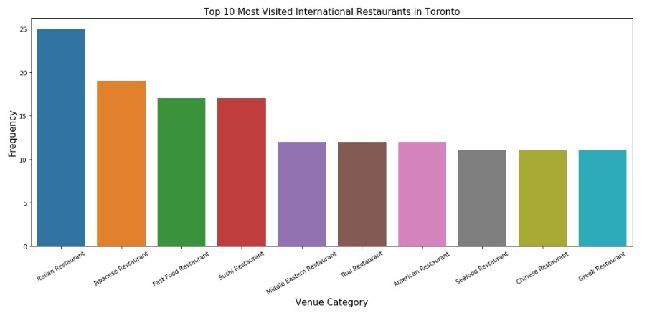
Top 10 International Restaurant by Frequence in Toronto

Slide 12
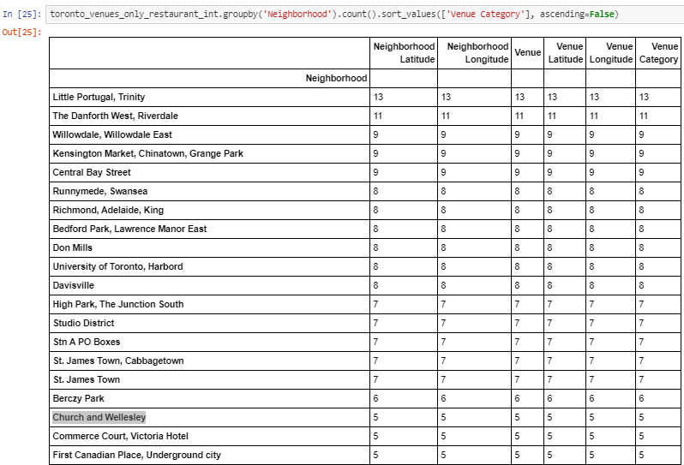
The Ethiopian House is the only African Restaurant in Toronto
It’s located at Church and Wellesley, which among the top 25 neighborhoods by number of international restaurants

Slide 13
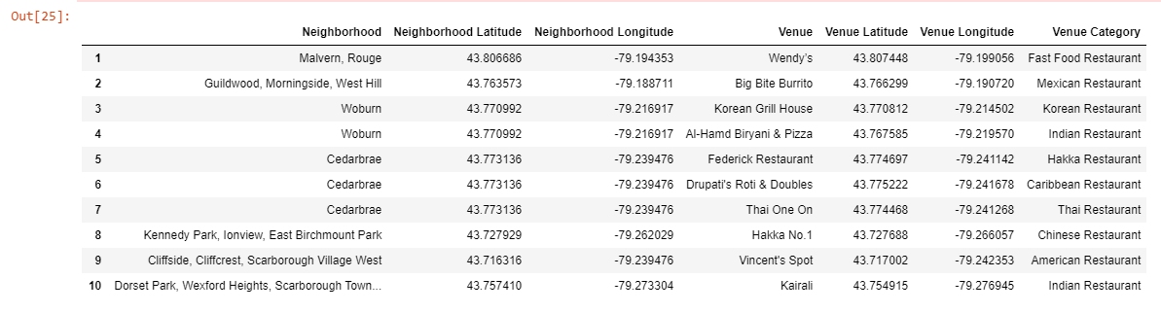
The Final data frame with venues categories

Slide 14
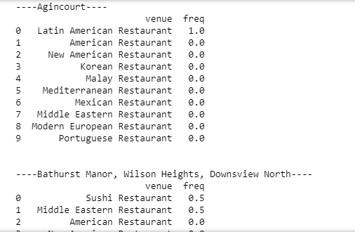
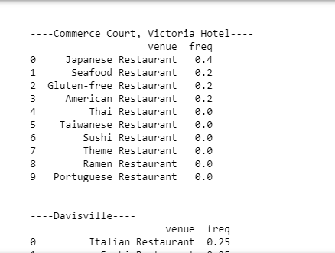
Print Each Neighborhood along with the Top 10 Most Common internal restaurant

Slide 15
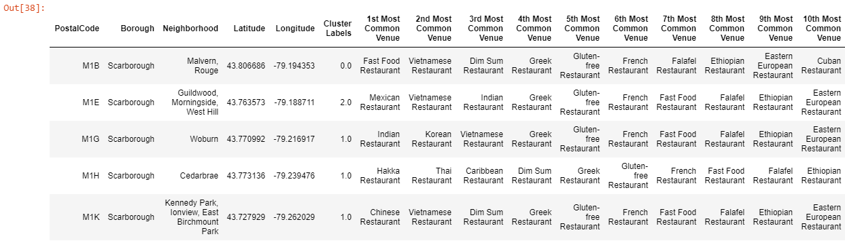
Clustering the Neighborhoods by Using K-Means
K-means clustering algorithm identifies k number of centroids, and then allocates every data point to the nearest cluster while keeping the centroids as small as possible. It is one of the simplest and popular unsupervised machine learning algorithms.

Slide 16
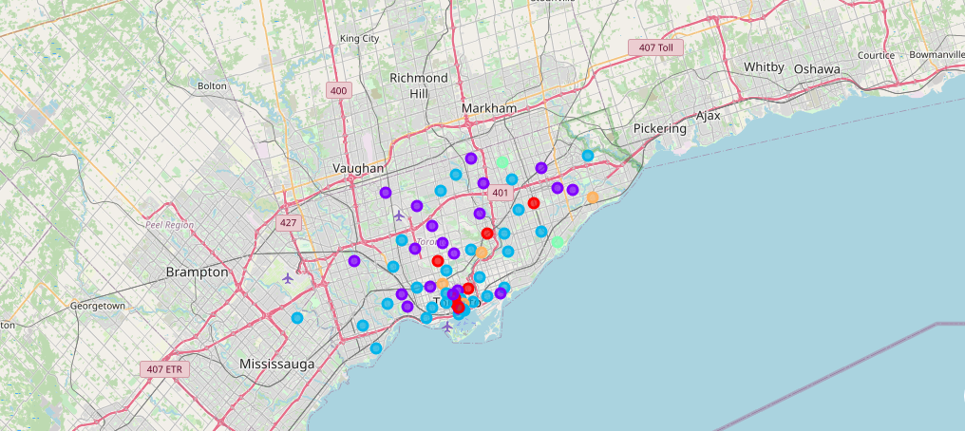
Clusters Visualization

Slide 17
Cluster Selection for Opening the few African Restaurants
K-means clustering show the results into 5 clusters based on the most venues in each borough. As per Toronto census 2016, the top visible-minority groups per Community Council are Toronto & East York, North York,Scarborough, and Etobicoke York, with the later two having the highest percentage of black population 10.8% and 15.7% respectively. The percentage of black population in Toronto and East York is 5.6%, and 5.2% in Etobicoke. Consequently the results of the clustering can be classified as follows:
Cluster 1: 4/8 of the boroughs are communities with the highest black percentage
Cluster 2: 13/22 of the boroughs are communities with the highest black percentage
Cluster 3: 11/29 of the boroughs are communities with the highest black percentage
Cluster 4: no neighborhoods with the highest black percentage, but the only Ethiopian Restaurant in Toronto is opened in Toronto Downtown, at at Church and Wellesle, which is little weird
Cluster 5: 1/4 of boroughs are communities with the highest black percentage
Therefore , the suggested clusters for opening the a few restaurants in Toronto are cluster 1,and 2, and specifically in East York, North York,Scarborough, and Etobicoke York.

Slide 18
Discussions
The selection of cluster 1 and 2 were based on the number of borough having the highest number of black population.
Cluster 3 could also be considered, since it's the cluster with the highest number of boroughs, but just lag behind in terms of number of communities having the highest percentage of black population. Moreover, 9/29 of the boroughs are Toronto Downtown, where the Ethiopian Restaurants is actually opened. The overall,results could be better if the population and nationalities data per neighborhood were available so that we can spot and target the right neighborhoods with African communities.

Slide 19
Conclusion
There are many ways to conduct this analysis, but I chose the methods I chose the method I selected as it was a straightforward way to narrow down the options, not complicating what is actually simple in many ways such as focusing of international restaurants only. Form this project, it can be concluded that data science and machine learning are great ways predictions or decisions making on such risky projects.Without leveraging data, the project could end up opening the restaurants in the clusters 4, and 5, which are the boroughs with nn or east communities with black population.
I also tried to incorporate the data of Toronto's population categorised per immigrants, immigrants percentage, and neighborhoods in order to improve the research quality, but could not find the right data. However, this is not an end point of this research, but rather a starting point that will guide the next part of the process to spot the right locations for a such a project. The next part will involve domain knowledge of the industry, and perhaps, of the city itself.

Slide 20

Thank You!

